Slide 1
 | NEPAL

Slide 2
 |  |  | NEPAL

Slide 3
NEPAL

Slide 4
 | NEPAL

Slide 5
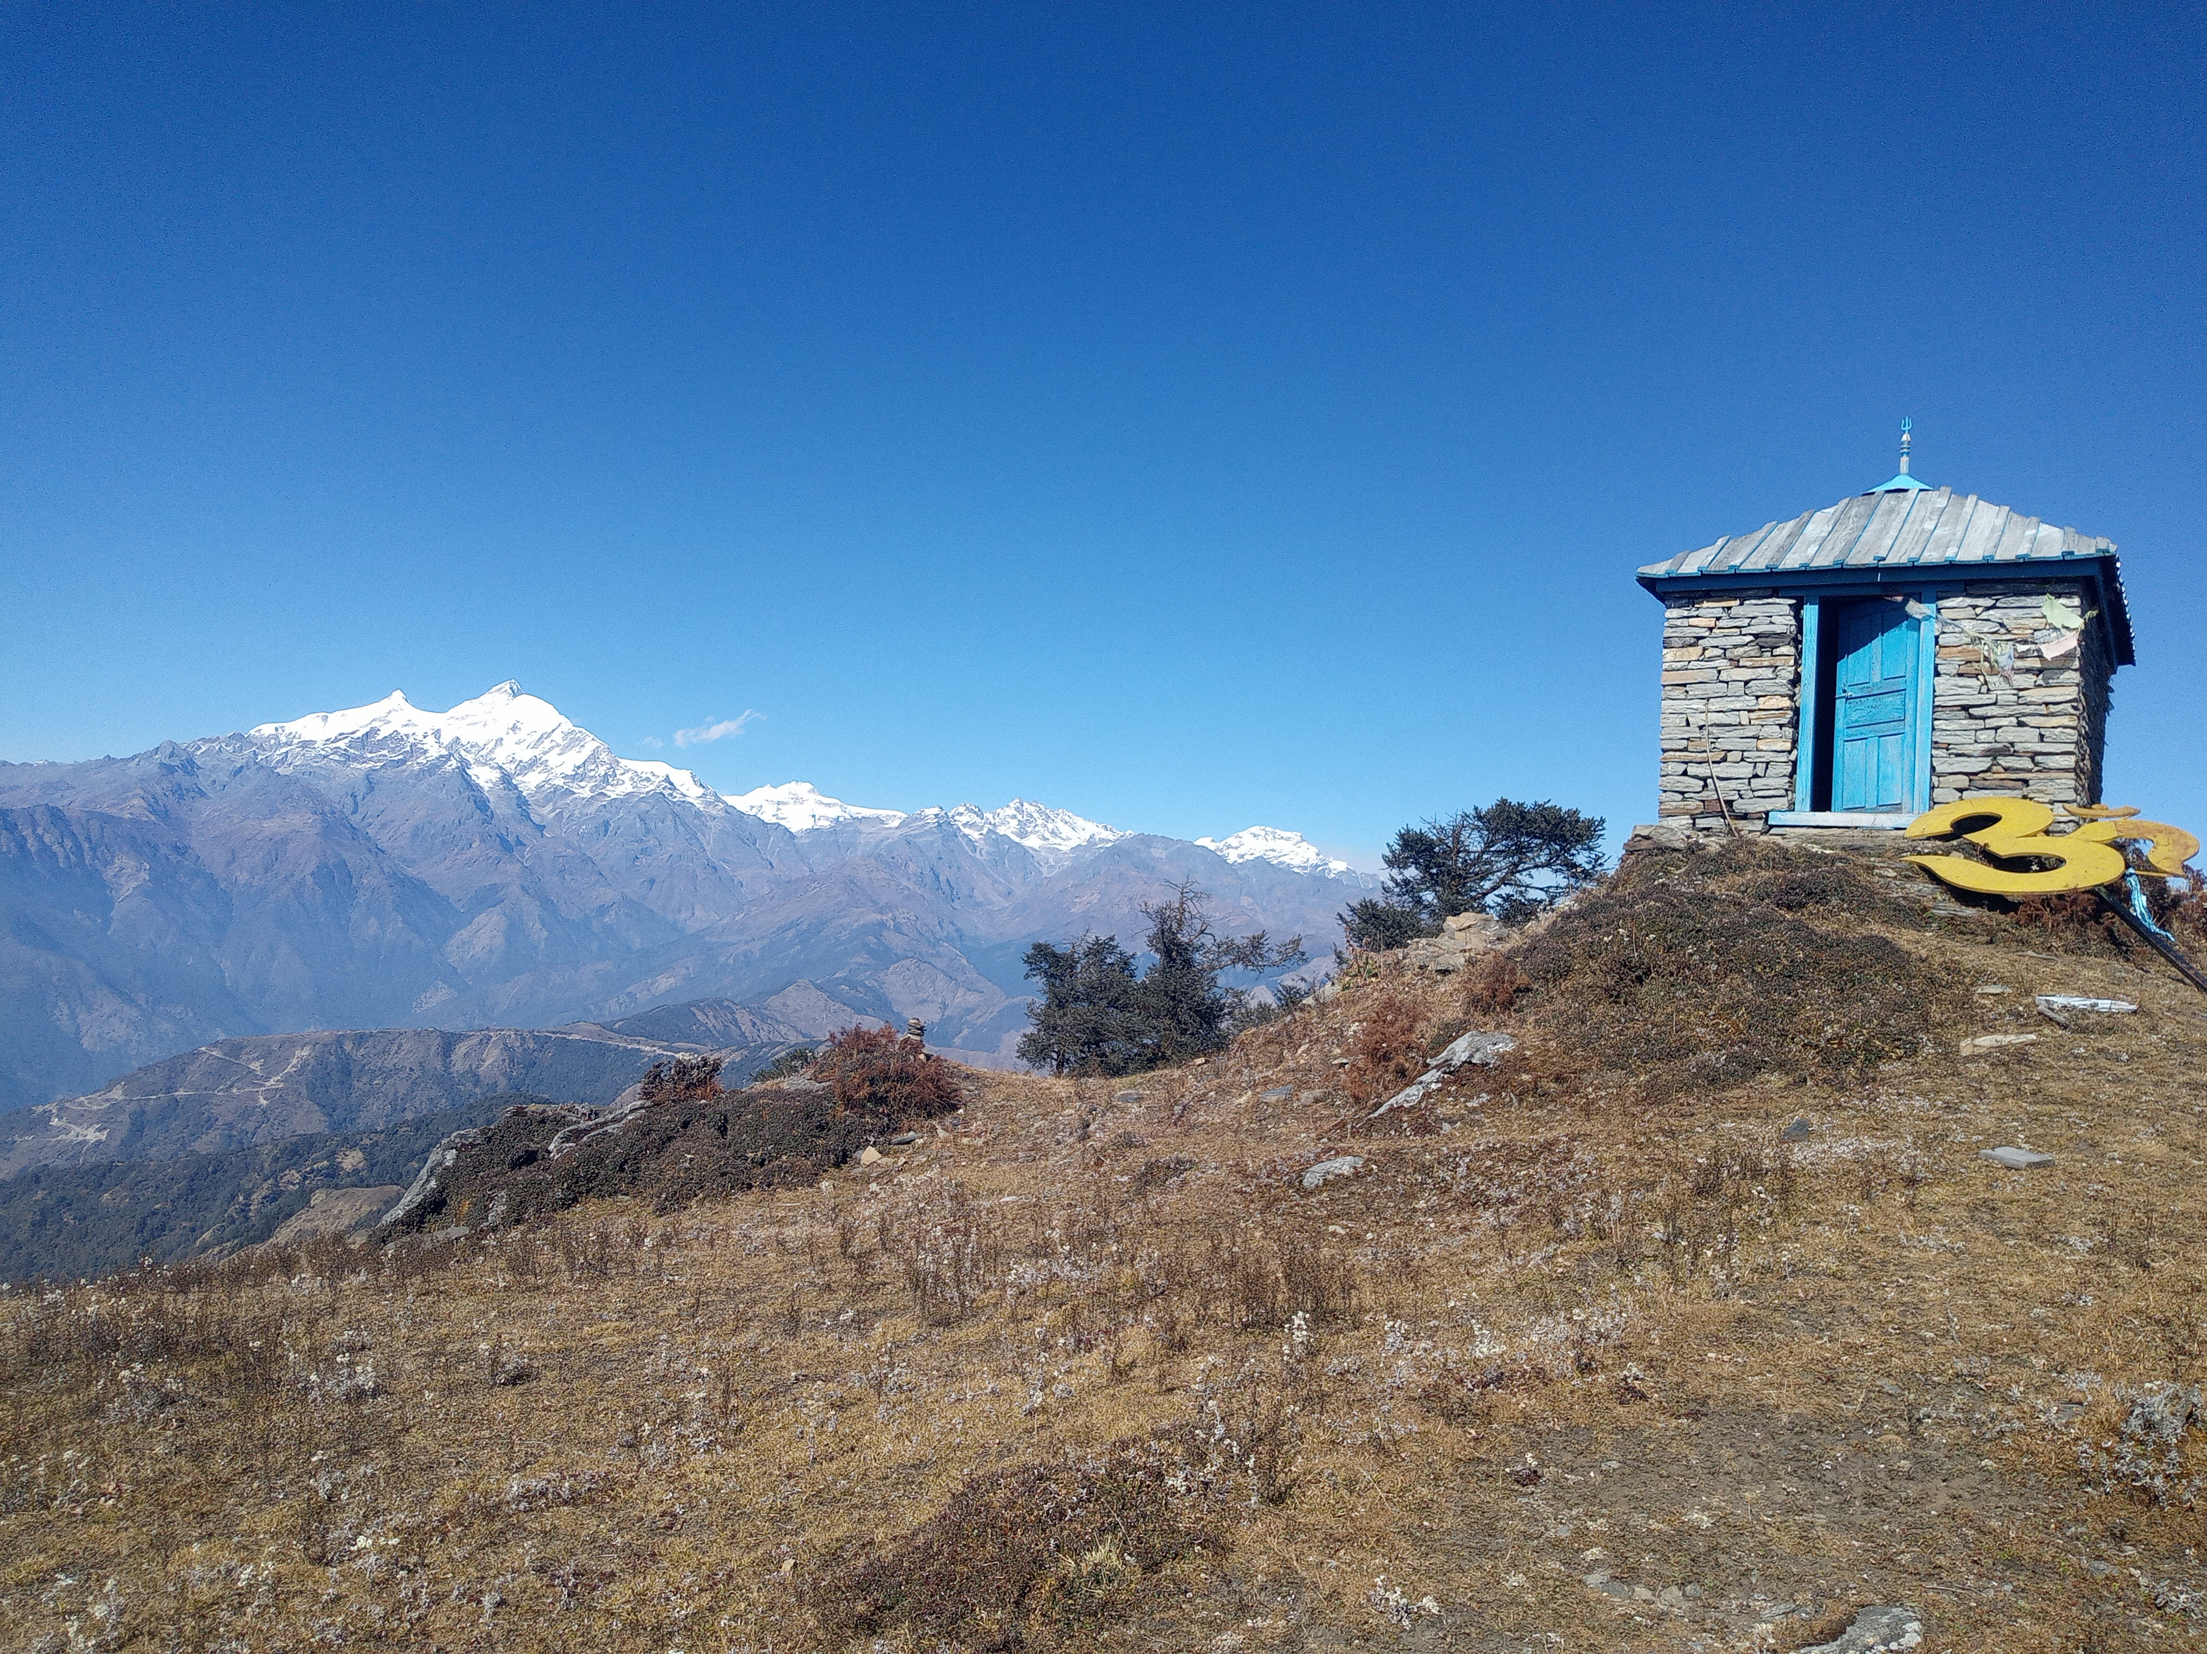
 | NEPAL

Slide 6
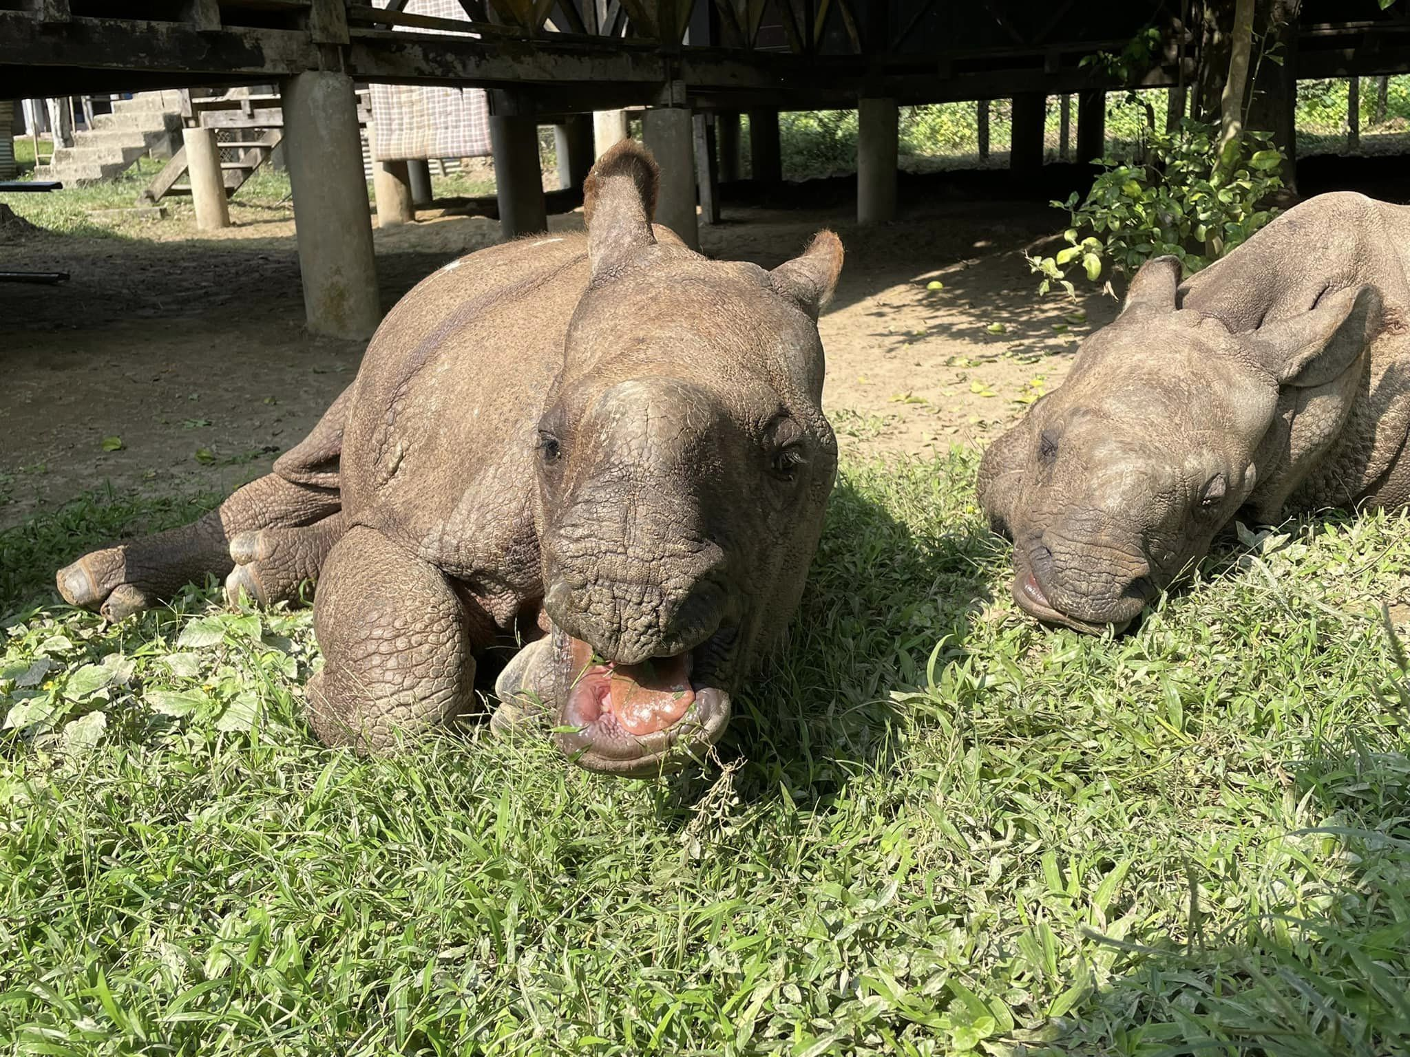
BIODIVERSITY |  |  |  | Rihnos
Crocodiles
 |  |  | Tigers

Slide 7
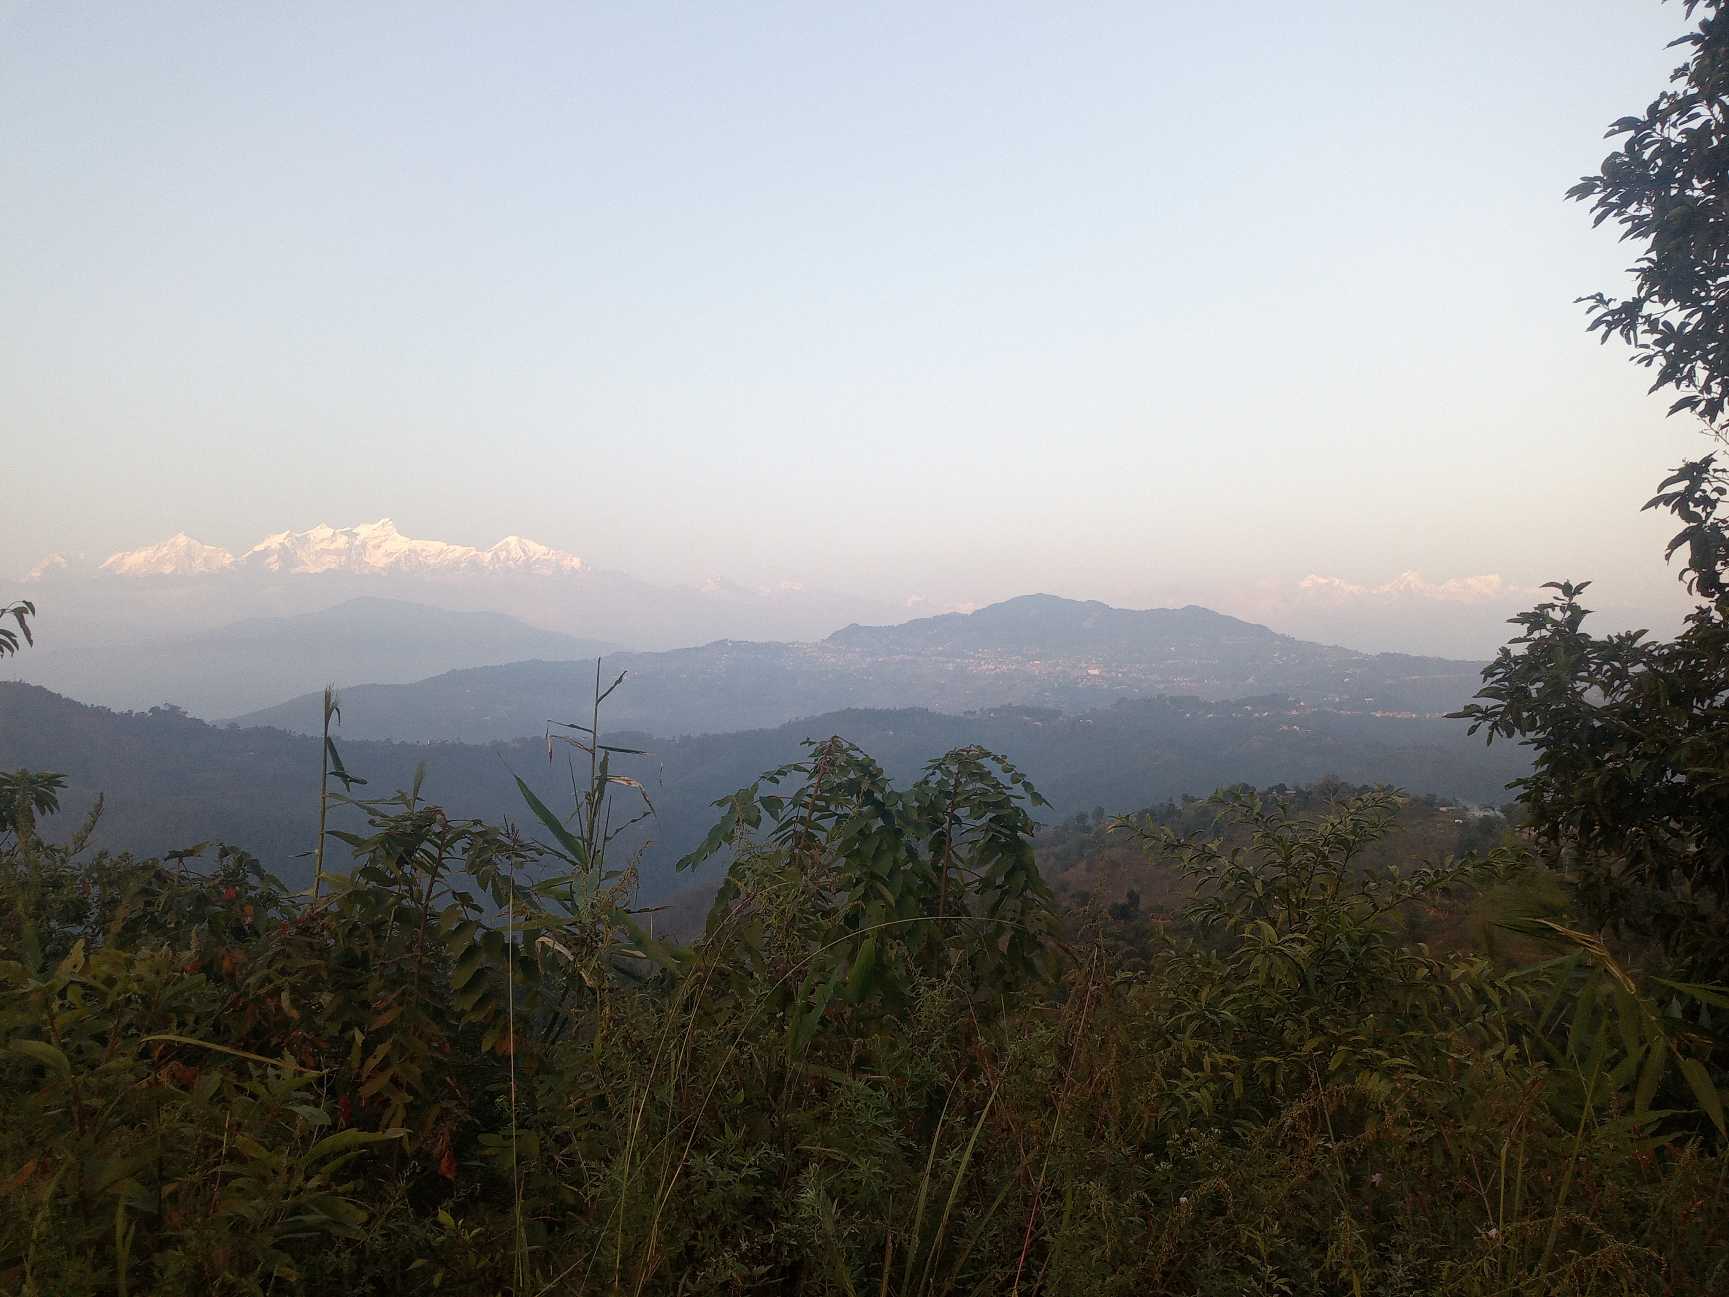
 |  | DIVERSE LANDSCAPE

Slide 8
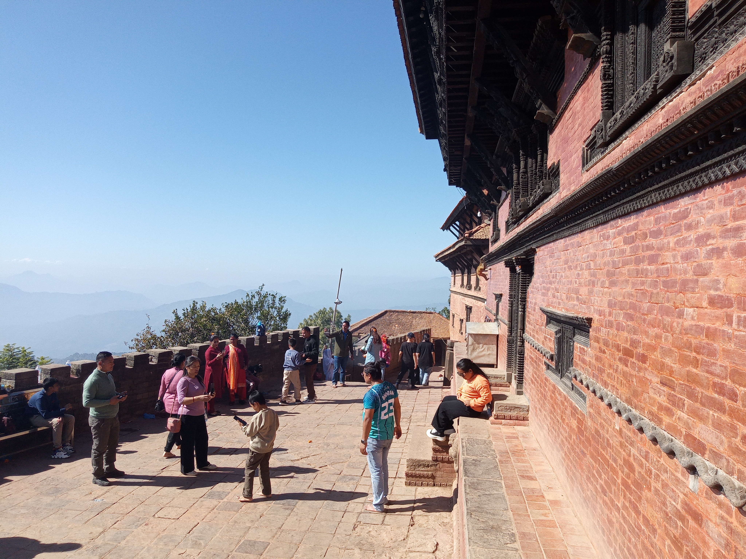
RICH CULTURE
 | 10 UNESCO World Heritage Sites

Slide 9
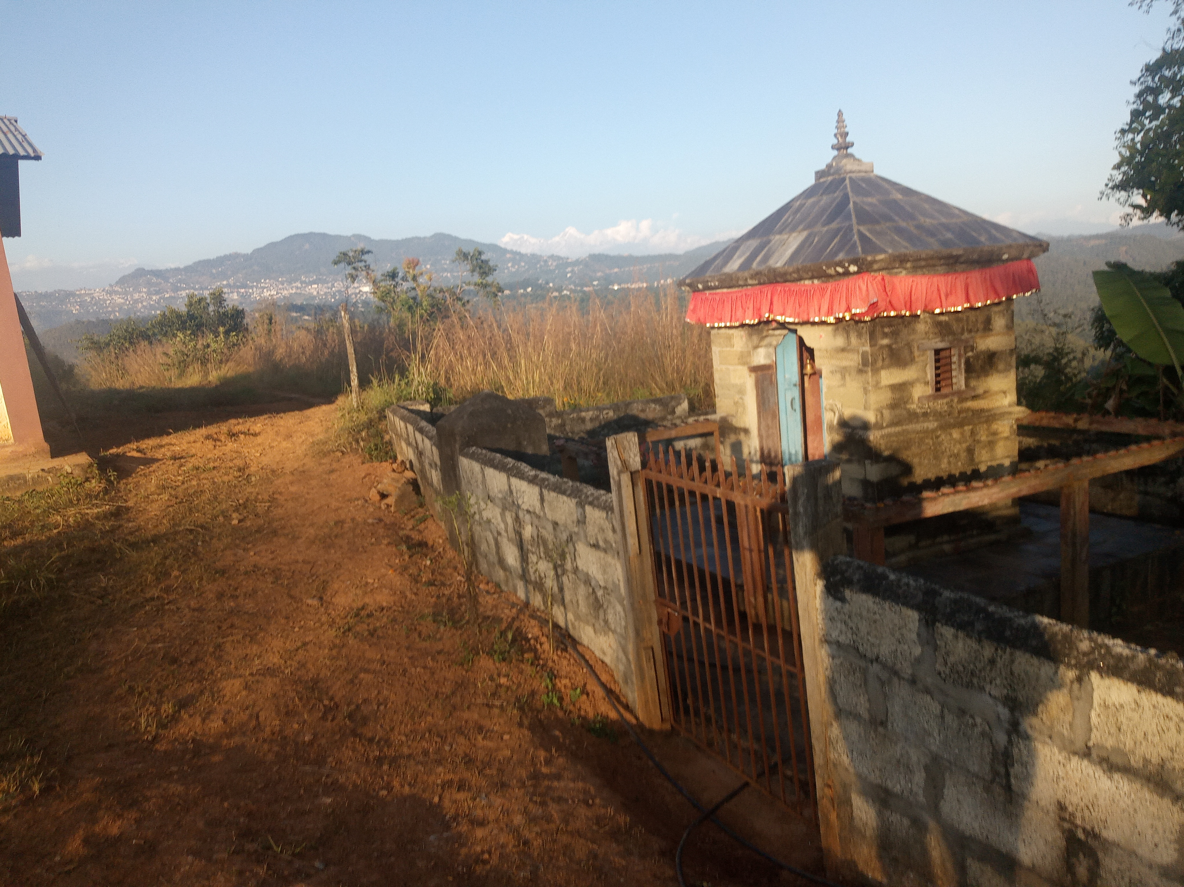
LAND OF DIFFERENT
 | Cultures
 |  |  | Religions
 |  |  |  |  | Languages

Slide 10

NEPAL IS A GREAT PLACE

